Slide 1
US Superstore Sales Performance Dashboard
Excel | Power Query | Pivot Tables | 2015-2018
Princess Ohiri-Okere

Slide 2
Project at a Glance:
📊 Dataset US Superstore Sales
📁 Records 9,800 Transactions
📅 Period 2015 – 2018
🔧 Tool Microsoft Excel
Full analysis and working file available at: https://github.com/Princess-Okere/Superstore-Sales-Dashboard.git

Slide 3
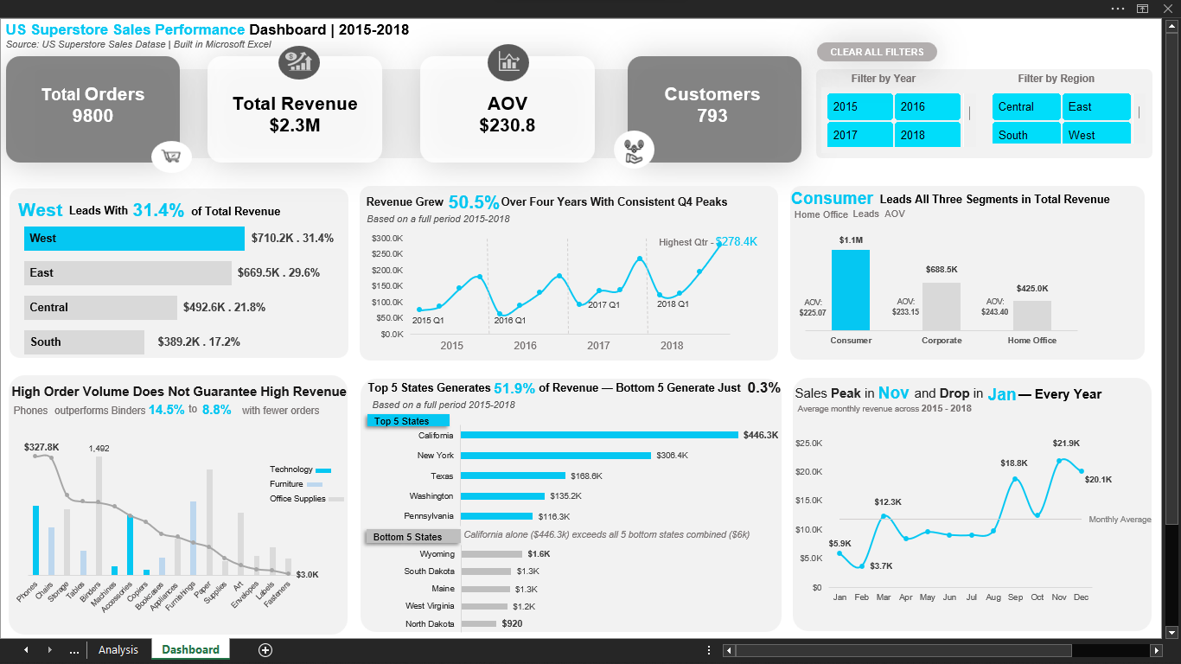
Interactive dashboard with Year and Region filtering

Slide 4
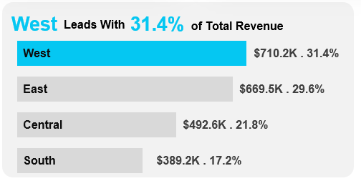
Regional Performance
Key Findings
▶ West leads with 31.4% of total revenue
▶ South trails at 17.2% — a 14.2 point gap behind West
▶ East and West together account for 61% of all revenue
▶ Revenue is geographically concentrated — two regions dominate

Slide 5
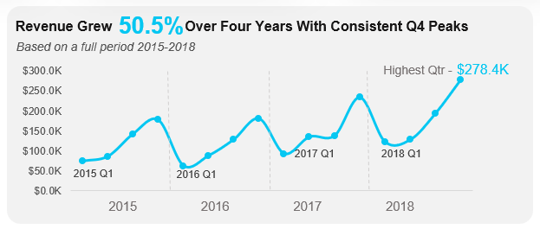
Revenue Trends (2015-2018)
Key Findings
▶ Overall, revenue followed a consistent
upward trajectory across all four years.
▶ Q4 peaks every year — the highest
quarter in each year is always Q4
without exception.
▶ A recurring Q1 dip visible across all four years.
▶ 2016 shows the flattest period — peaks
and troughs remained at similar levels
to 2015.
▶ Growth visibly accelerated from 2017 —
both peaks and troughs rose sharply
through 2017 and 2018.
▶ Highest single quarter: 2018 Q4
at $278.4K.

Slide 6
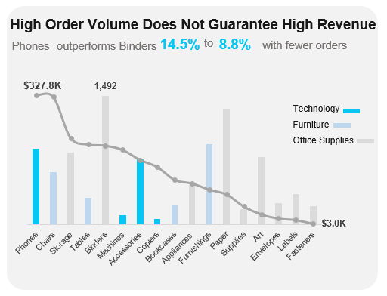
Category Performance
Key Findings
▶ Technology leads revenue despite fewest transactions
▶ Phones: 14.5% of total revenue ($327.8K)
▶ Binders: 1,492 orders — most transactions, only 8.8% of revenue
▶ High volume ≠ high revenue

Slide 7
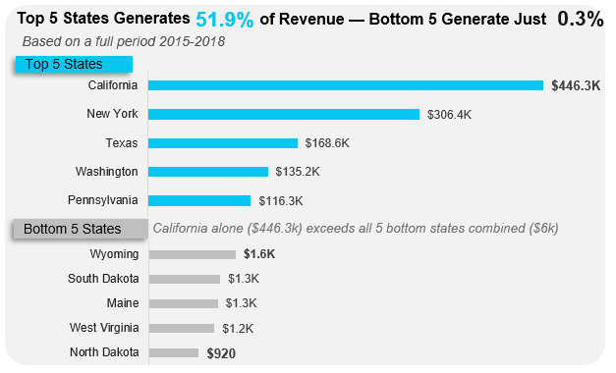
Geographic Performance
Key Findings
▶ Top 5 states = 51.9% of
total revenue.
▶ Bottom 5 states = just 0.3%.
▶ California alone ($446K)
exceeds all bottom 5 states
combined ($6K).
▶ North Dakota: $920 total
across four years.

Slide 8
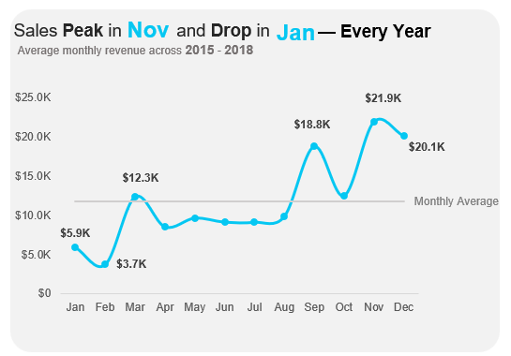
Seasonal Patterns
Key Findings
▶ November is the strongest
month every year ($21.9K avg).
▶ September produces a
consistent mid-year peak.
▶ January is the weakest month
every year ($5.9K avg).
▶ This pattern repeats across
all four years — structural,
not random.

Slide 9
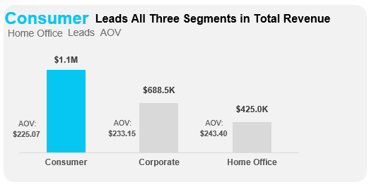
Customer Segments
Key Findings
▶ Consumer generates the highest revenue but has the lowest AOV — indicating strong performance driven by order volume.
▶ Home Office has highest AOV
at $243 — reflecting fewer yet higher-value purchases.

Slide 10
Business Recommendations
Based on the analysis findings:
1. Strengthen West region investment — defend the dominant 31.4% revenue position.
2. Develop South region strategy — 17.2% share signals underdevelopment relative to other regions.
3. Build Q1 recovery campaigns — January consistently underperforms; preventable with targeted promotion.
4. Prioritize Technology category growth — highest revenue per transaction across all sub-categories.
5. Target Home Office segment expansion — highest AOV, lowest customer count, largest untapped growth opportunity.
6. Focus geographic acquisition in top-performing states — California, New York and Texas show proven buying behavior.

Slide 11
Skills Demonstrated
Technical
Analytical
Microsoft Excel
Power Query (data cleaning)
Pivot Tables & GETPIVOTDATA
Dynamic KPI cards
Slicer-driven filtering
Combo, line & bar charts
VBA macro
Business question formulation
Volume vs value analysis
Seasonal pattern identification
Geographic performance analysis
Customer segmentation
Insight communication
Dashboard design principles

Slide 12
View the full project on GitHub: https://github.com/Princess-Okere/Superstore-Sales-Dashboard.git
Includes: Working Excel file | Full analysis | Interactive dashboard | README documentation
Princess Ohiri-Okere

